Slide 1

Shell Scripting
Yahya İZALA
Computer Sc. Phd.

Slide 2
Commands
$ date
$ who
$ pwd
$ ls
$ cat > myfile
$ more myfile
$ mv file
$ rm file
$ tail +20 <hotel.txt | head –n30 > hlist
expr 2+5 (just linux)
$ rm –rf oldfiles
$ chmod u+x, g+wx, o+x
$ mail
$ logout
$ wc ashis
$ grep fox myfile
$ sort myfile
-r reverse
-n numeric
-nr reverse and numeric
$ tail +5 myfile (last line)

Slide 3
Conditional commands
If condition
then
command
else
command
fi
If condition
then
command
elif condition then
command
else
command
fi
if [ $var –eq 10 ]
then
echo “somt”
elif [ $var –gt 30] then
echo “hha”
fi

Slide 4
Conditional commands
for {variable_name} in {list}
do
commands
done
for i in 1 2 3 4 5
do
echo $i
done

Slide 5

Conditional commands
while [condition]
do
commands
done

Slide 6
functions
funcname(){
commands
}
sayHello(){ echo “hi” }

Slide 7

Switch
case var
in
pat) command
command
;;
pat) command
command
;;
esac

Slide 8

More commands
cut command
$ cat file | cut –c1 -3
$ cat file | cut –d: -f3,5
diff command
Checks differens line by line

Slide 9

Sum function
sum=0
for i in “$@”
do
if [i –gt 10 ]
then
sum = $((sum+i))
fi
done
drintf “%s \n” $sum

Slide 10

samples
num=0
for i in {0..99}
do
num=$((num+i))
done

Slide 11

samples
make_and_enter(){
mkdir –p “$1”
cd “$1”
}
$make_and_enter

Slide 12
Output to variable
var_name=$(command)
current_user=$(who)
files= `sudo find . –type f –print | wc –l `

Slide 13
Calendar (cal)
$ cal
$ passwd
$ users
$ who
$ logout
$ login

Slide 14

System shutdown
$ halt
$ init 0
$ init 6
$ poweroff
$ reboot
$ shutdown
Creating files
$ vi filename

Slide 15
Read file (cat)
$ cat –b filename
$ wc filename (word count)

Slide 16

Copy files
$ cp filename destfilename
$ mv oldfile newfile
$ rm filename
$ cd ~ (home dir)
$ cd – (last dir)
ChMode
$ chmod u-x test
$ chmod u+x test

Slide 17

CHMOD
$ chmod g=rx test
$ chmod o+wx,g=rx test
Changing owner and groups
$ chown (kimin bu dosya)
$ chgrp
$ chown user filelist
$ chgrp group filelist

Slide 18

Mail
$ mail [-s subject] [-c bcc-addr] to_addr
$ mail –s ”test msg” admin@abc.com
Grep command
$ grep pattern
$ ls –l | grep “aug”
-v all lines
- n match line and line number
-l names and match lines
-c matched line count
-I ignore lowercase uppercase

Slide 19

Sort Command
$ sort command
$ sort food (a-z)
-n
-r
-f
-v (verbose)
-q
-c
+x
$ ls –l | grep “aug” | sort +4n | more
$ head (from top)
$ head -n 5 state.txt

Slide 20

Process Management and other tools
$ ps
$ ps –f (f for full print)
$ ps -axc
- a all users
-x process without terminals
-v additional opt.
-e extended information
Kill process
$ kill –g process_id

Slide 21

Tools
PING
$ ping hostname or ip_add
$ ping google.com
FTP
$ ftp hostname or ip_add
commands
put, get, mput, mget ,prompt off, prompt on, dir, cd ,lcd, quit

Slide 22

Tools
TELNET
$ telnet hostname or ip_address
$ telnet amrood.com
$ finger
$ finger amrood.com

Slide 23
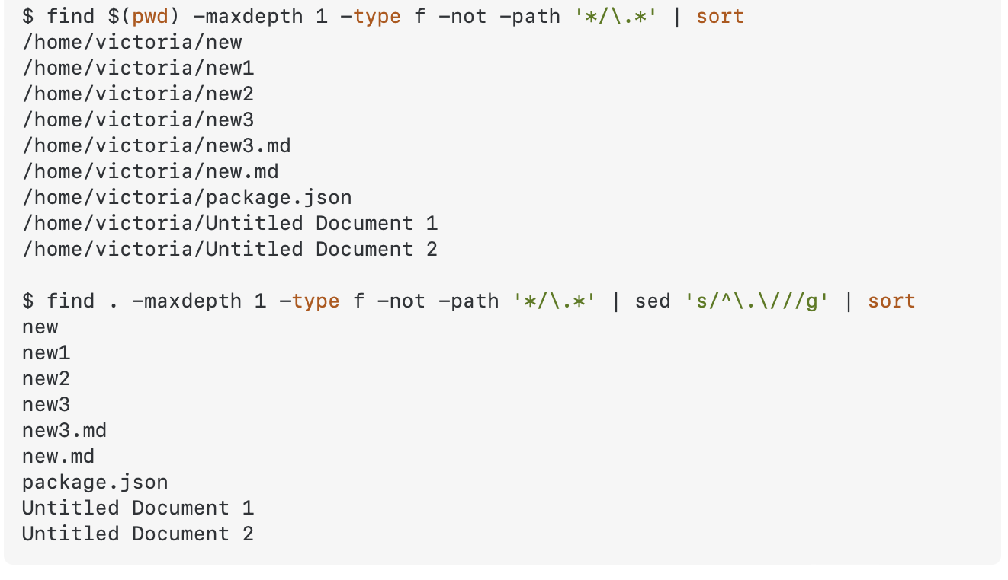
enumarate
$ for entry in "$search_dir"/* "$work_dir"/*
do
if [ -f "$entry" ];then echo "$entry" fi
done

Slide 24
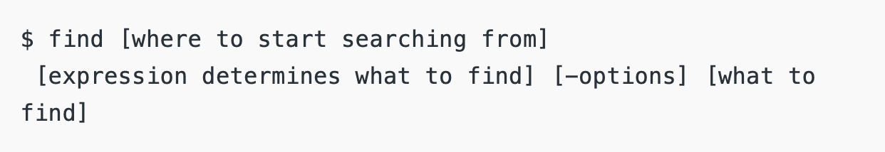
find

Slide 25
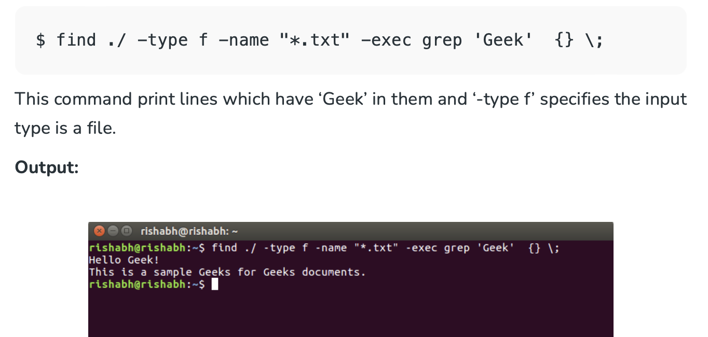
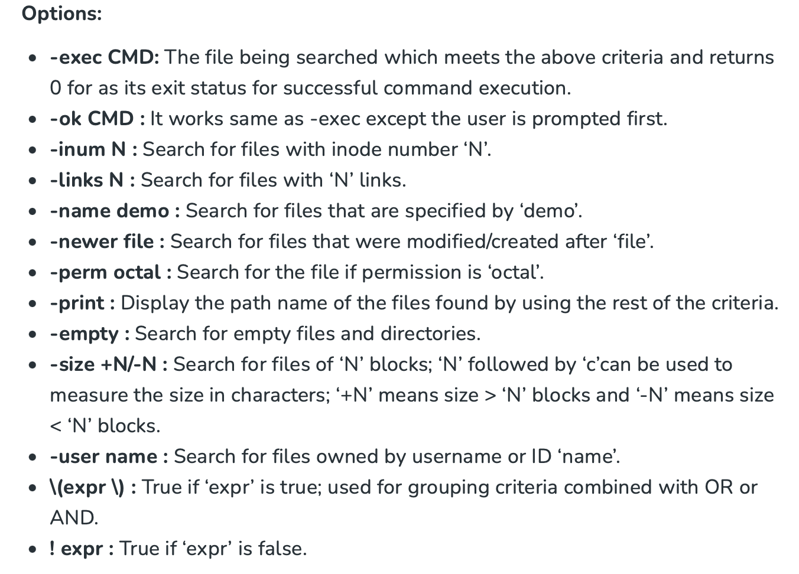
find
more details at :
https://www.redhat.com/sysadmin/linux-find-command
https://linuxhint.com/use-the-find-command-in-linux-to-search-files/

Slide 26
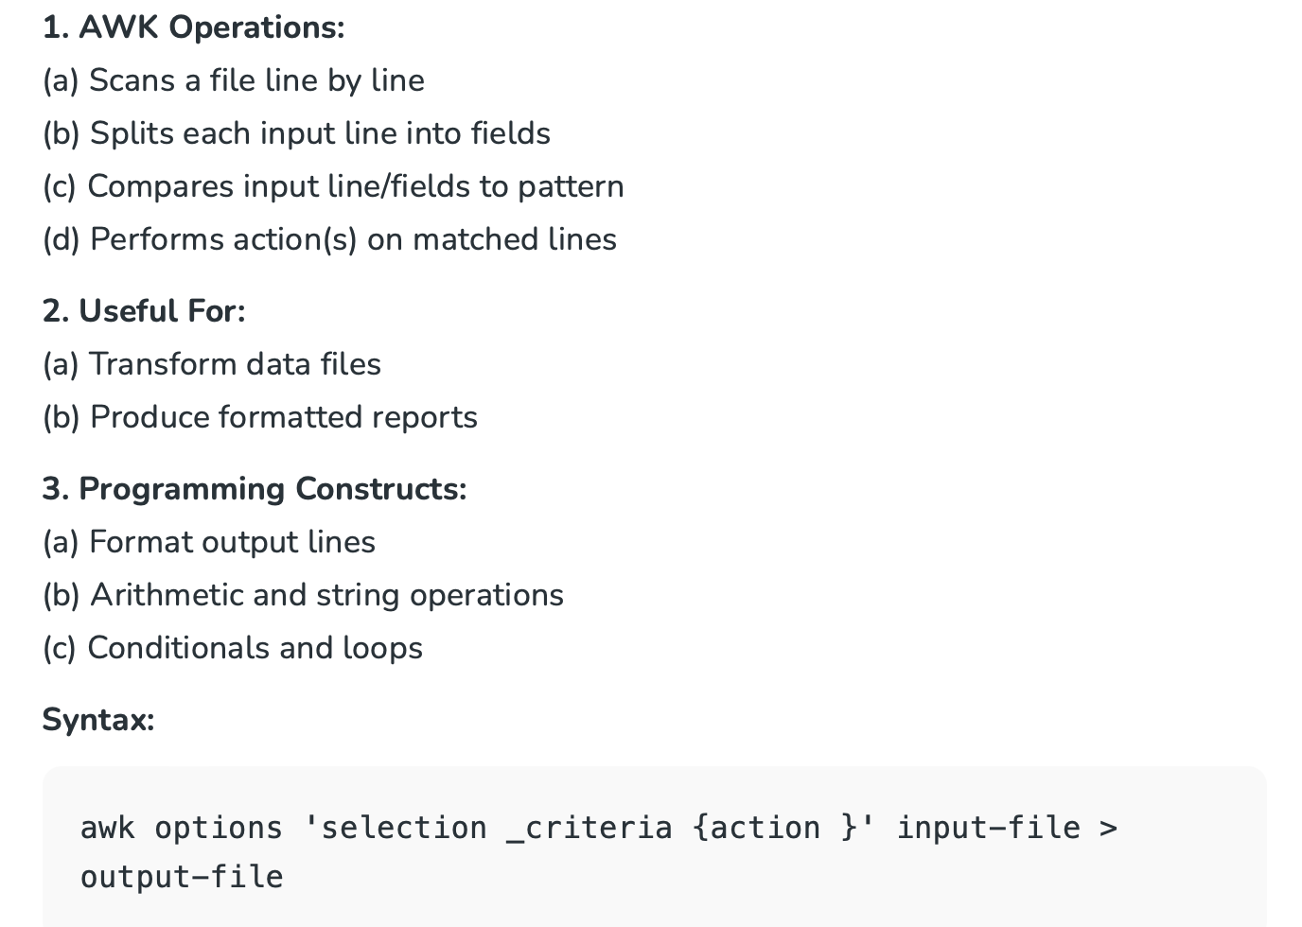
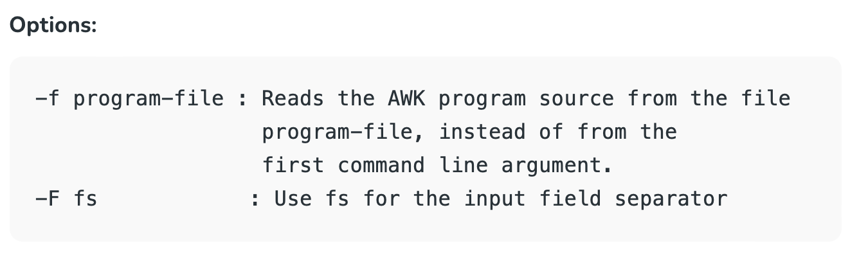
awk

Slide 27
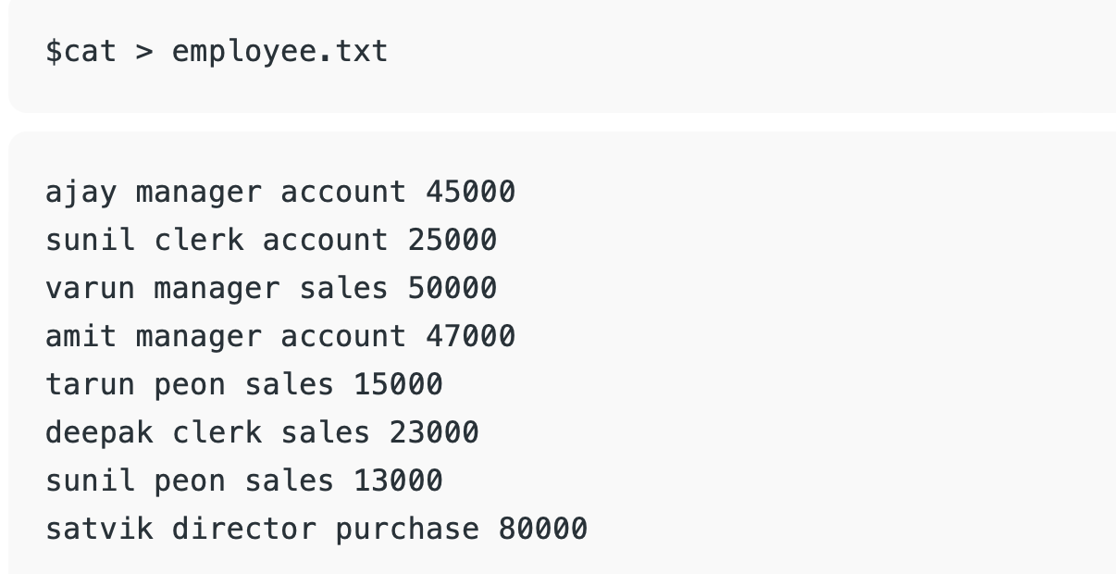

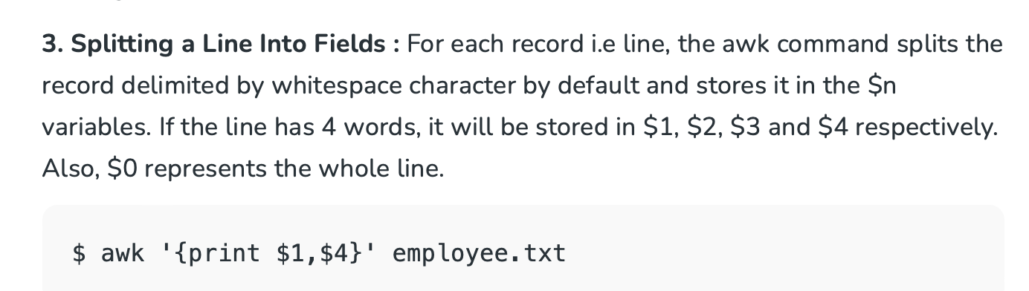

awk

Slide 28
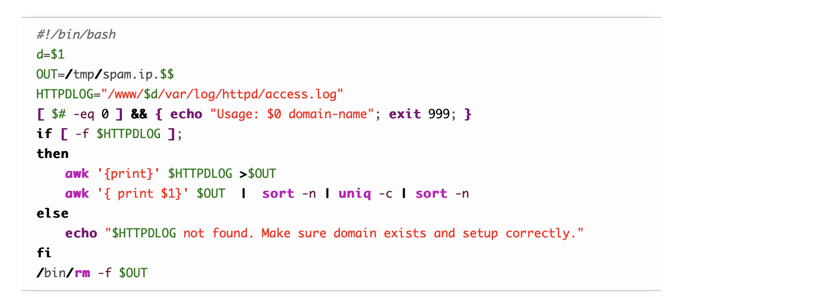
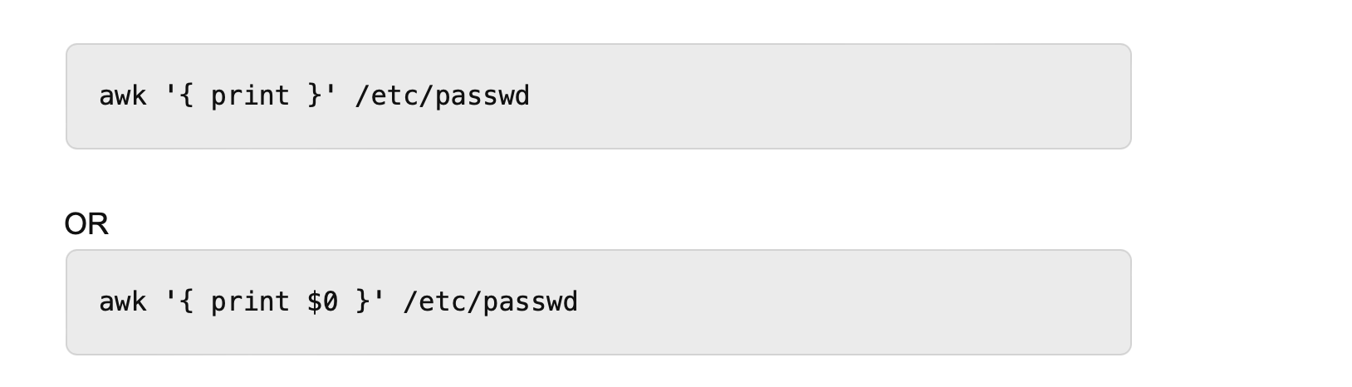
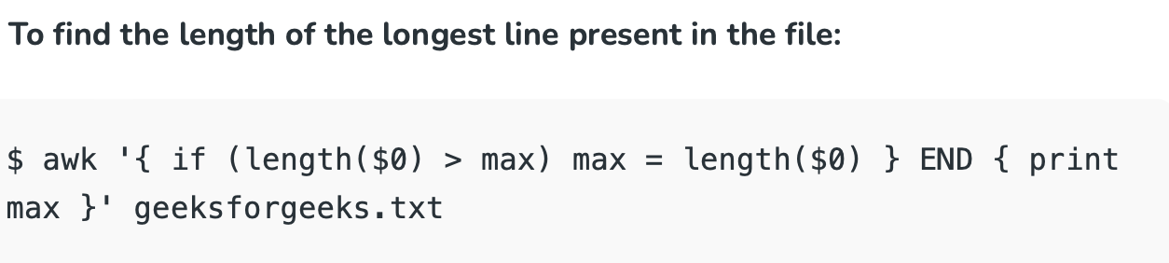
awk

